Slide 1

Lecture 1
FinTech

Slide 2
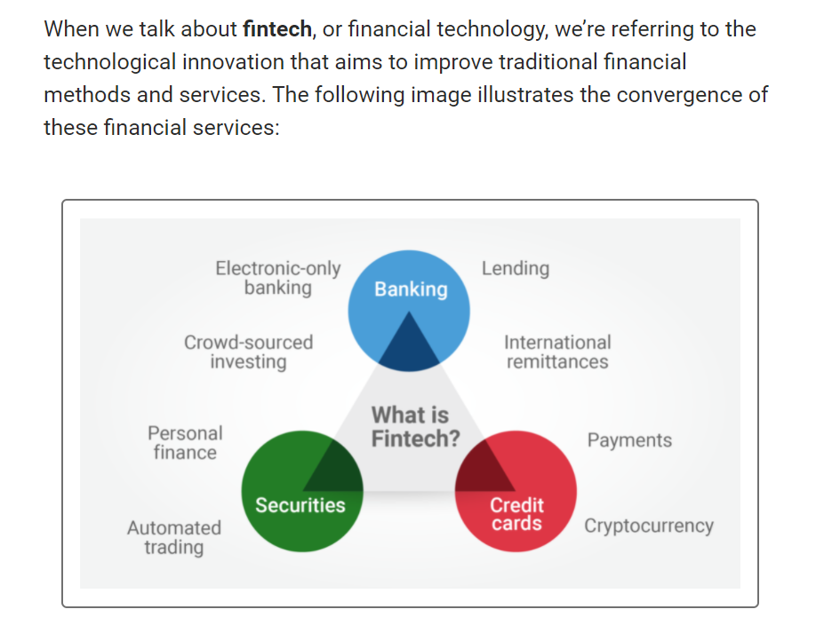

Slide 3
Job openings have surged especially for the following roles, and more:
Financial analysts
Risk analysts
Quantitative traders
Investment data analysts
Software engineers ( Hard: following this course)
Technology consultants
Financial managers
Research analysts
Financial applications developers

Slide 4
Automation
New York Stock Exchange—floor trading has largely been replaced with algorithms that can automatically buy or sell financial orders on the exchange.
Tools like Python, APIs, machine-learning algorithms, and more all deal with and enable automation in some way. This course will give you insight into and extensive practice with all of them.

Slide 5
Big Data and Cloud Infrastructure
The term cloud infrastructure refers to on-demand computer services (servers, databases, and software) that are accessible via the internet.
Mobile Infrastructure

Slide 6
Blockchain and Cryptocurrency
Cryptocurrency, the original application of blockchain technology, provides a means for people around the world to transact with each other without interference. It has also been used as an escape from hyperinflation.
Amazon, Microsoft, JPMorgan Chase

Slide 7
Programming and Financial Library Tools
Python
Pandas
PyViz
NumPy
SciPy
APIs: Application Programming Interface, which is a software intermediary that allows two applications to talk to each other.
Amazon Web Services (AWS): cloud computing platform
SQL: programming and designed for managing data held in a relational database management system

Slide 8
Machine-Learning Tools Branches
Supervised and unsupervised learning
Deep learning
Natural language processing
conversational AI
Cloud-based ML
Algorithmic trading Robo-advisors

Slide 9
Blockchain Tools
Wallets
Smart contracts
Cryptocurrencies

Slide 10
Terminal (CLI)
pwd (print working directory)
cd (change directory)
Ls (list)
mkdir (make directory) [Directory just means folder]

Slide 11
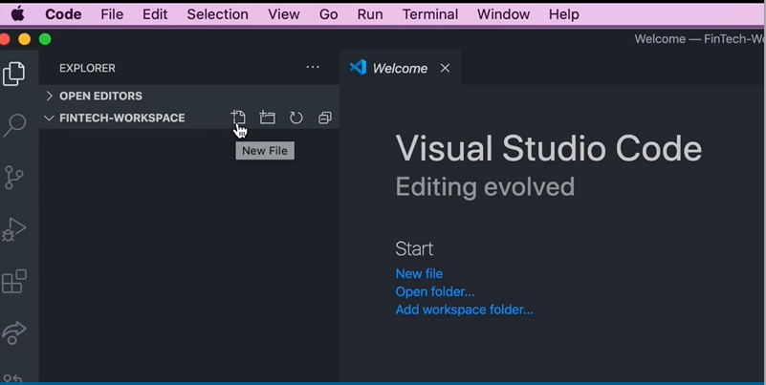
Visual studio code

Slide 12

Variables are a fundamental building block of all programming languages. They serve two primary functions: they hold the data in your code, and they use names that make sense to humans.
Snake case
Data types

Slide 13
Data types
Integer int 1
Floating float 12.595911
Double double 12.595922222222222222222222234555555
Char char ‘c’
String string ‘cat’
Bool bool True False
advanced dtypes class “combination”

Slide 14
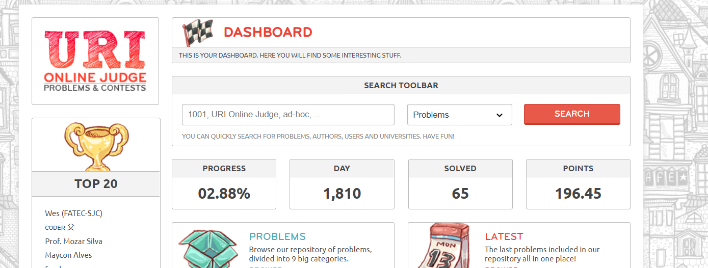
Uri online judge

Slide 15
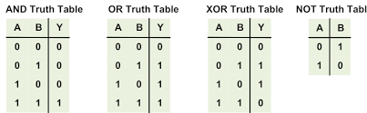
Boolean
buy_stock = stock_price < estimated_value
True/ False
Statement
and or
References: https://www.google.com/url?sa=i&url=https%3A%2F%2Fwww.realdigital.org%2Fdoc%2Fe127ebfa82dbc904b5c0dac5d1adce8e&psig=AOvVaw1bwKrEizEZzP0fPdaAocWL&ust=1628024373842000&source=images&cd=vfe&ved=0CAsQjRxqFwoTCLix0sWdk_ICFQAAAAAdAAAAABAD

Slide 16
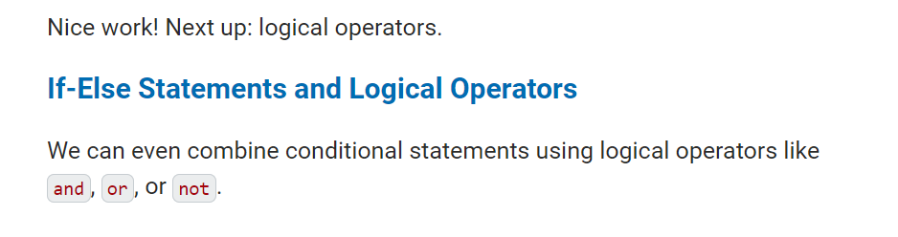
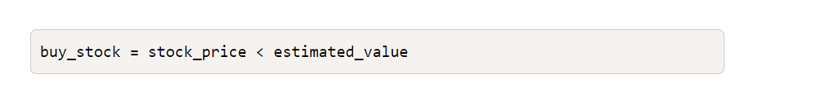
Boolean

Slide 17
List
[1,2,3,4,5,6]
[“Joe”,11,200.50]
Slice
Get maximum/minimum value
Get length
Do more things that we will learn later on.
sort
Access

Slide 18
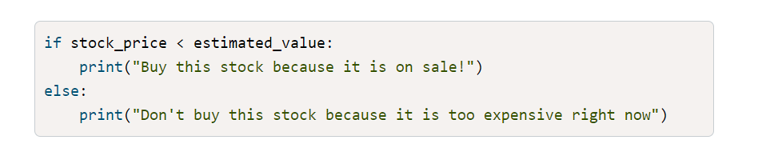
If elif else

Slide 19
Nested and Multiple conditions
Refer to code

Slide 20
Dictionaries: In Python, a dictionary is a data container for pairs of labels (or keys) and values. See the following example:
thisdict = { "brand": "Ford", "model": "Mustang", "year": 1964 }
Refrenceshttps://www.w3schools.com/python/python_dictionaries.asp

Slide 21
